Slide 1
Greyform Project
Design Preview

Slide 2
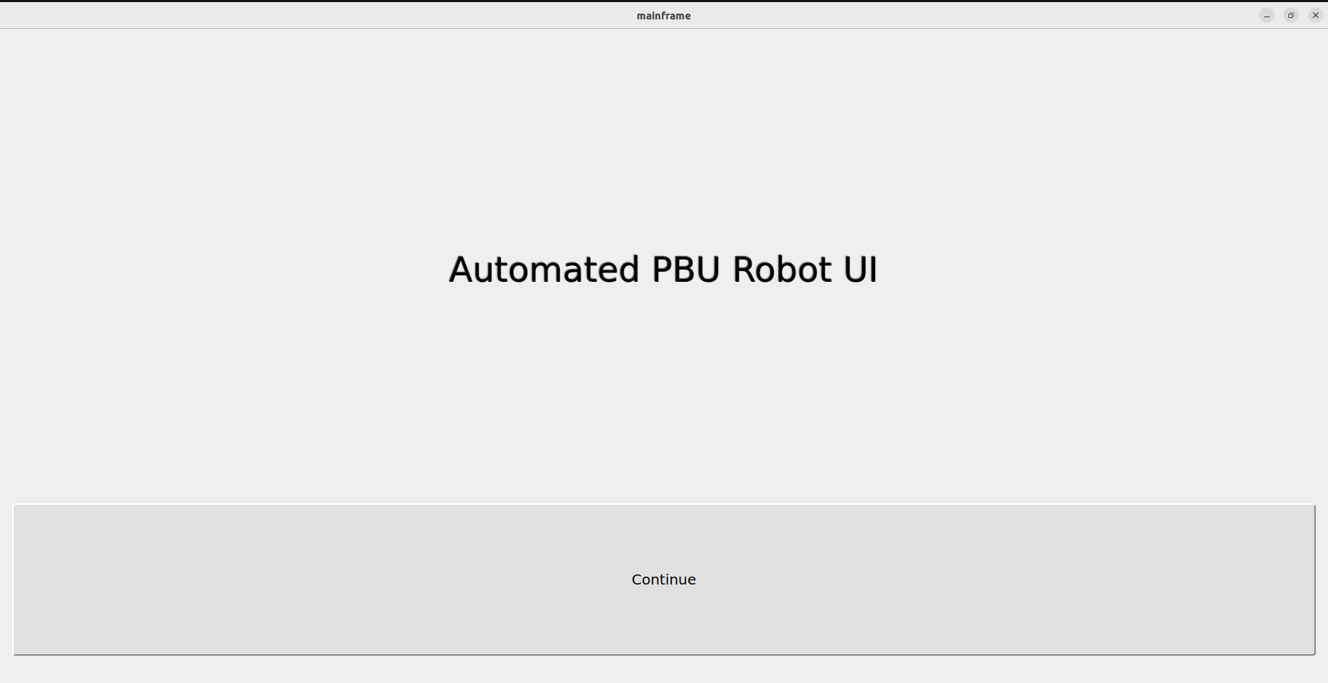
First page
The First page is a menu bar
User can continue or exit the program

Slide 3
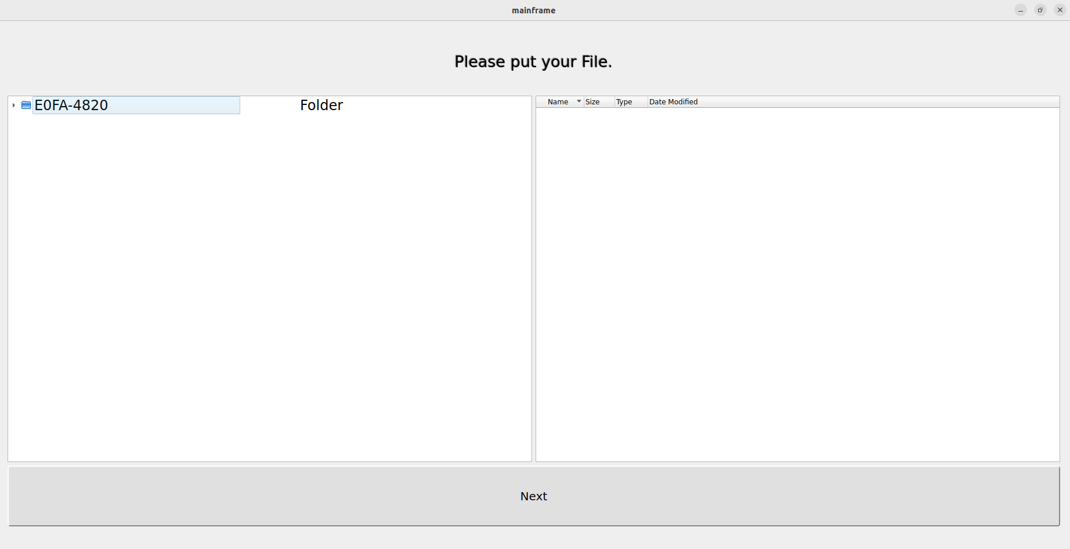
Second page
Folder Directory
File Directory
Folder Directory for the whole computer system
File is when the user click the file (only ifc)
File restricted for server , thumdrive , volumes and ifc , stl or dxf based on the picture.

Slide 4
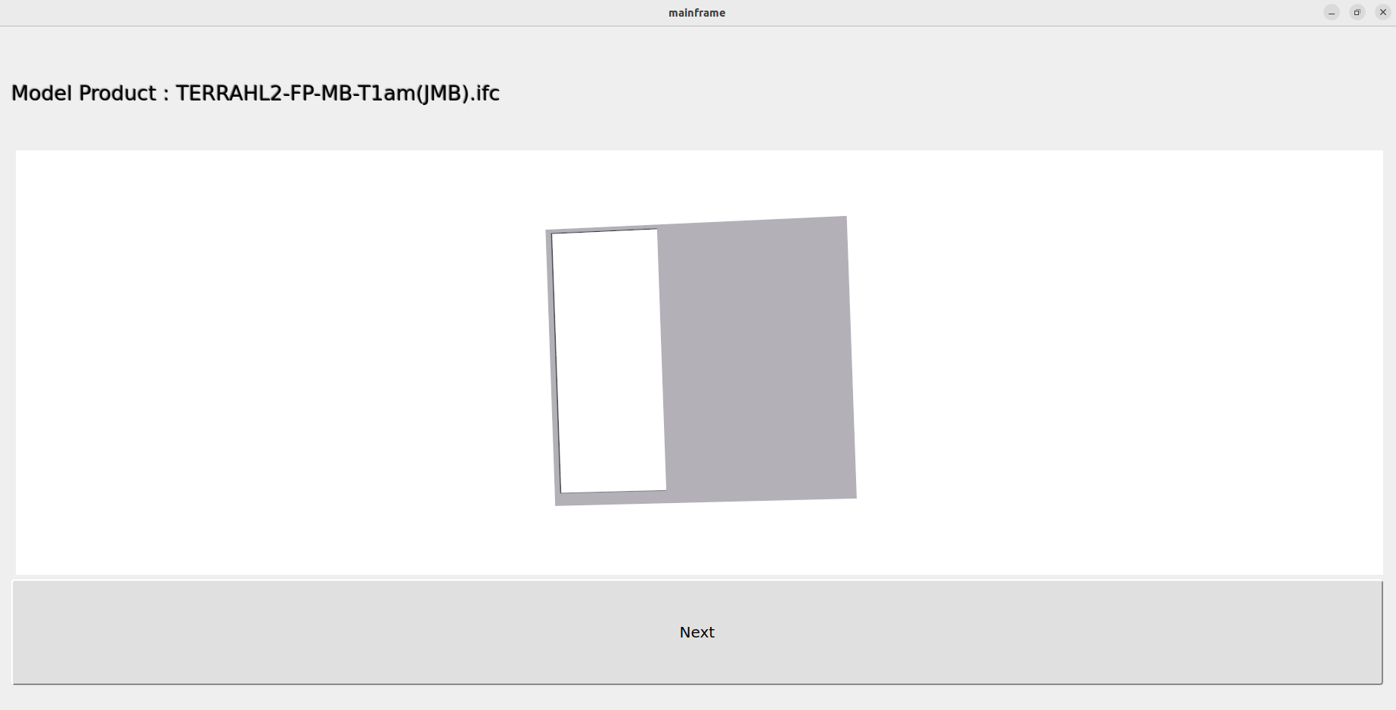
Third page
After the User click the file , the file will automatically pop up in the ui display
User can choose to continue extracting data from excel

Slide 5
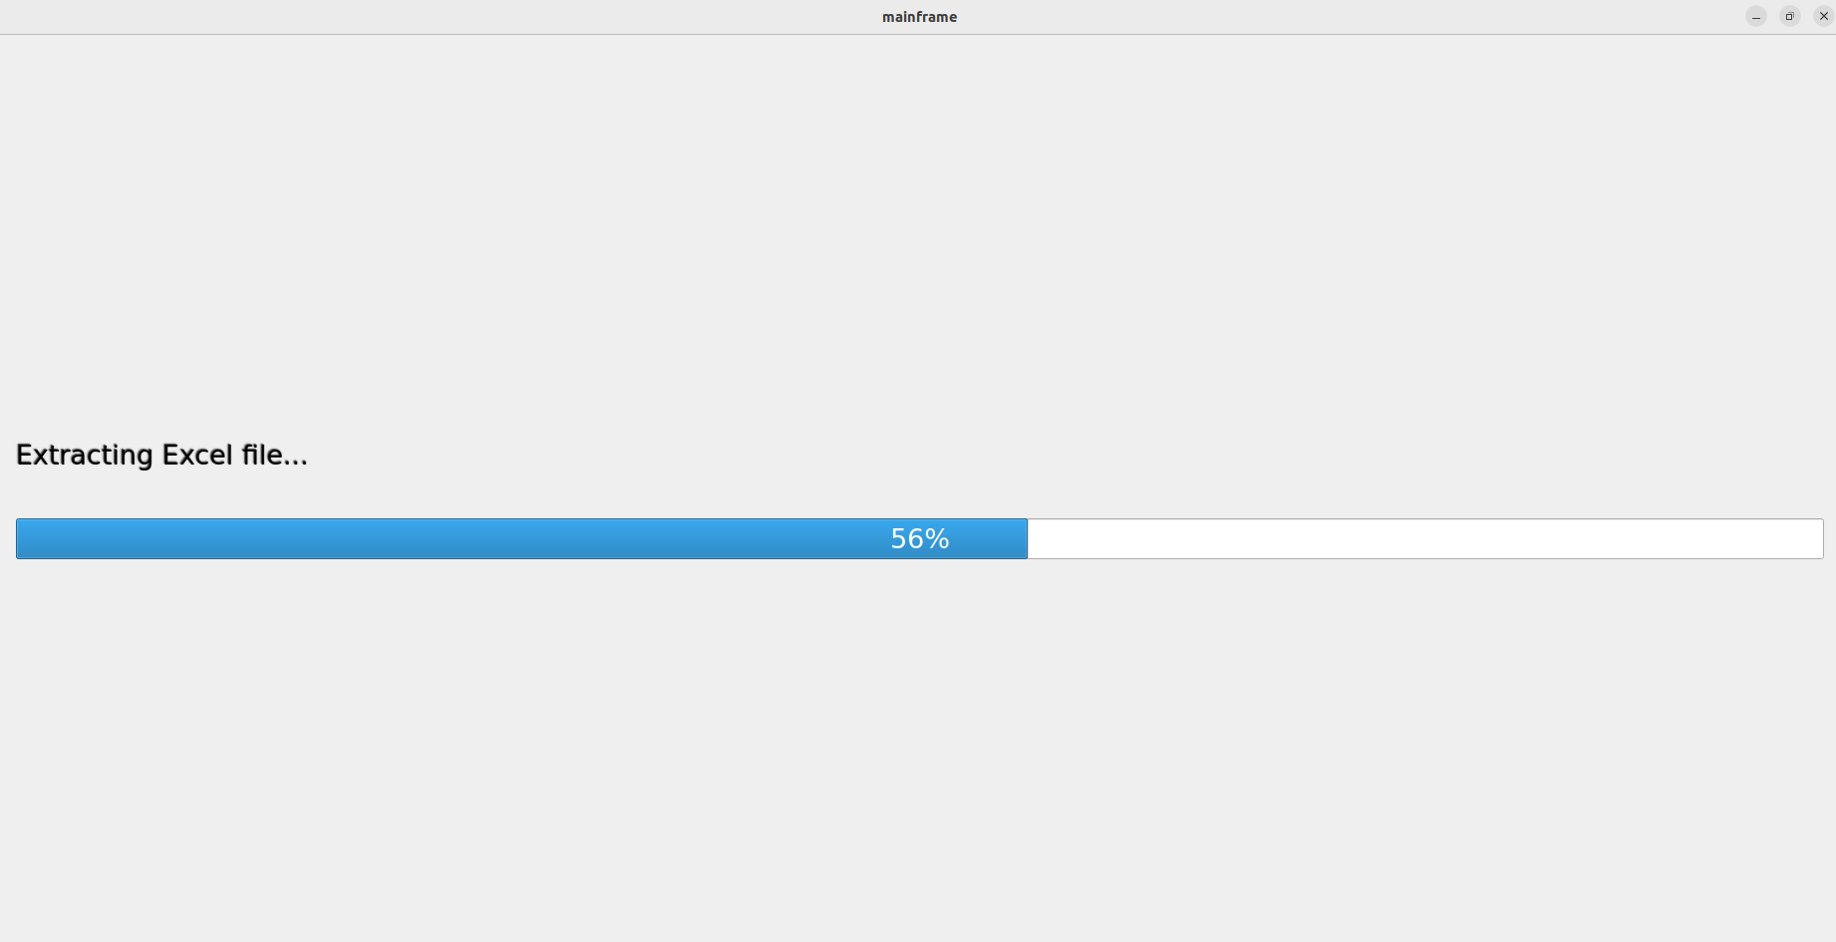
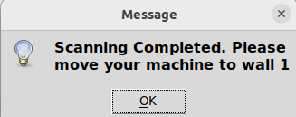
Scan Page
For the scanning page , the excel file will be extracted.
It will Automatically move to the walls display page after sending over

Slide 6
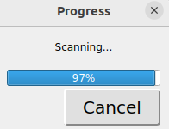
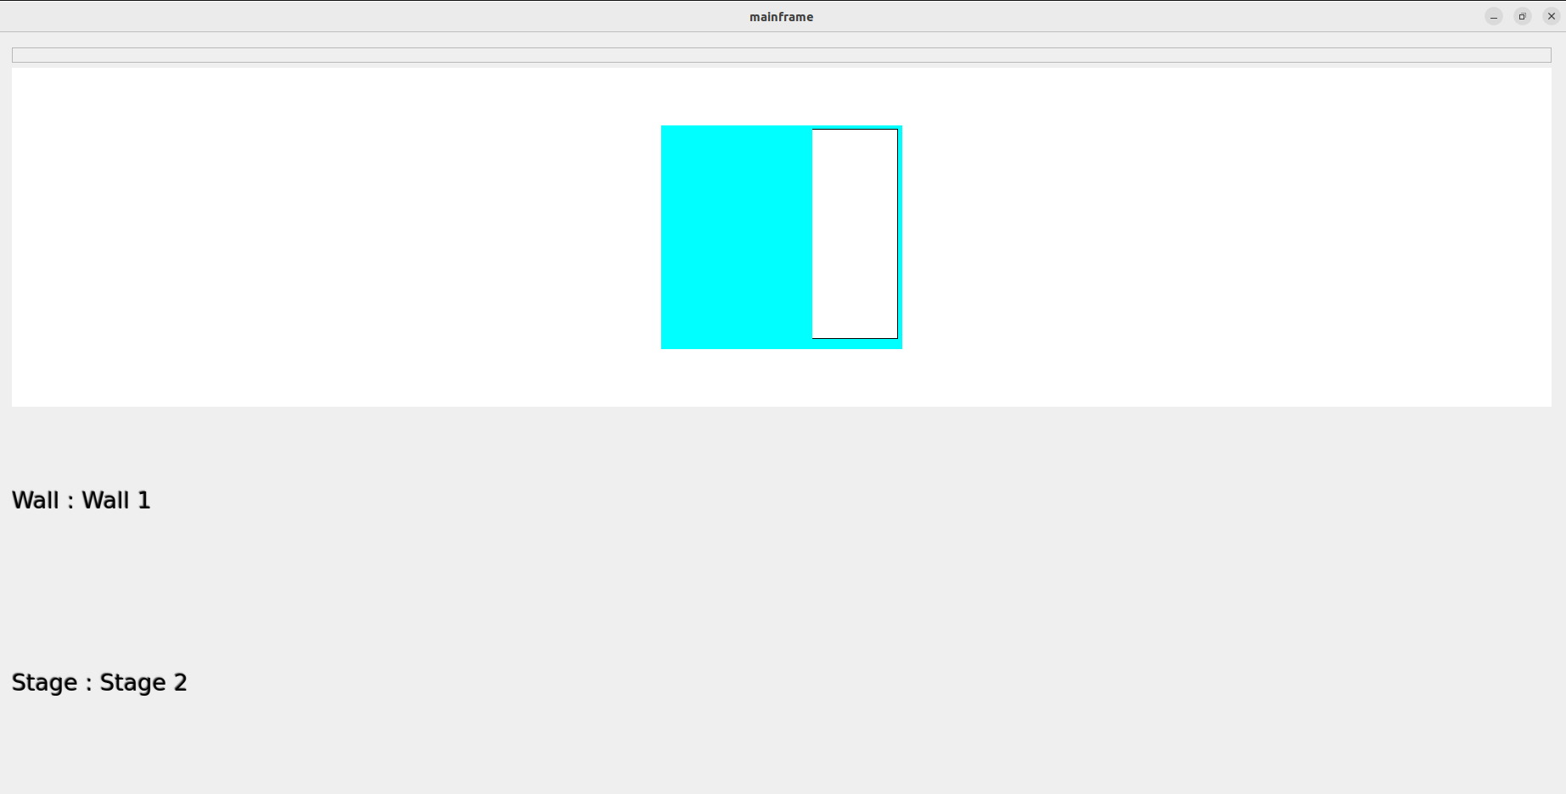
Wall Display Page Part 1
This wall display page is to automatically displayed the wall
Starting is Stage 2 Wall 1 since the robot cannot mark Stage 1 ,
It will scan sequencely from Stage 2 Wall 1 to Stage 3 by a click of a button
Camera view is included , when link to the camera

Slide 7
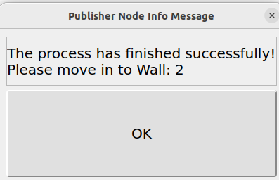
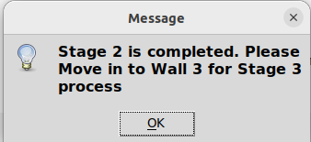
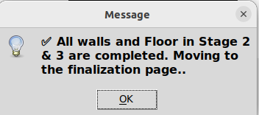
Wall Display Page Part 2
Once it right click , the program will scan the wall depending on the wall tile and fitting data
Duration : 6 min 16s for the whole stages Stage 2 and Stage 3 Wall 1 to wall F
Once all the wall and stages are marked finished , it will automatically move to the last page

Slide 8
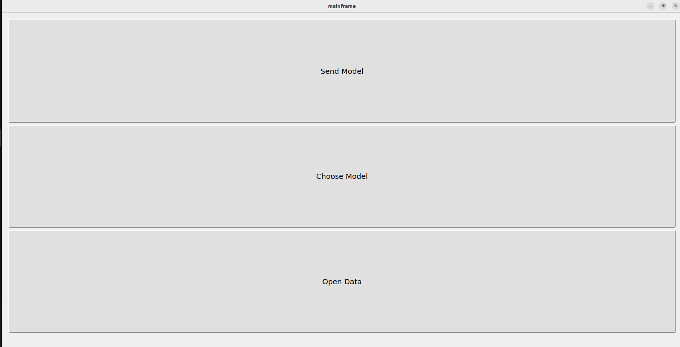
Final Ui Page
User can send model which is the finalization stage
User can choose another model so that it will go back to the file directory page(page 2)
User can close the program.
User can open the excel data for the status completion preview

